Slide 1

Efficient Resource Requests for Frontend Devs

Slide 2
What does that even mean?

Slide 3
Steve Tauber
For hire?
Future Branch Development
Cuddli

Slide 4
What it is
Browser Requests
HTTP
HTTP/2
Bundling?

Slide 5
What it isn’t
Tool or Framework Comparisons
Build flows
Server Configuration

Slide 6
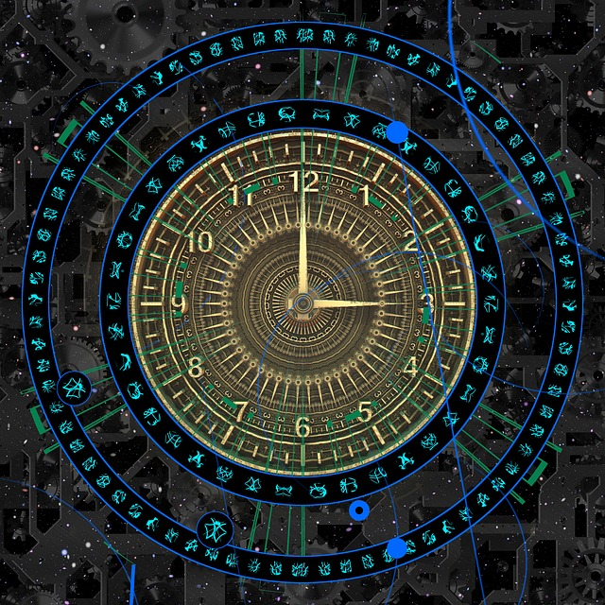

Slide 7

Notes:
1992

Slide 8


Slide 9
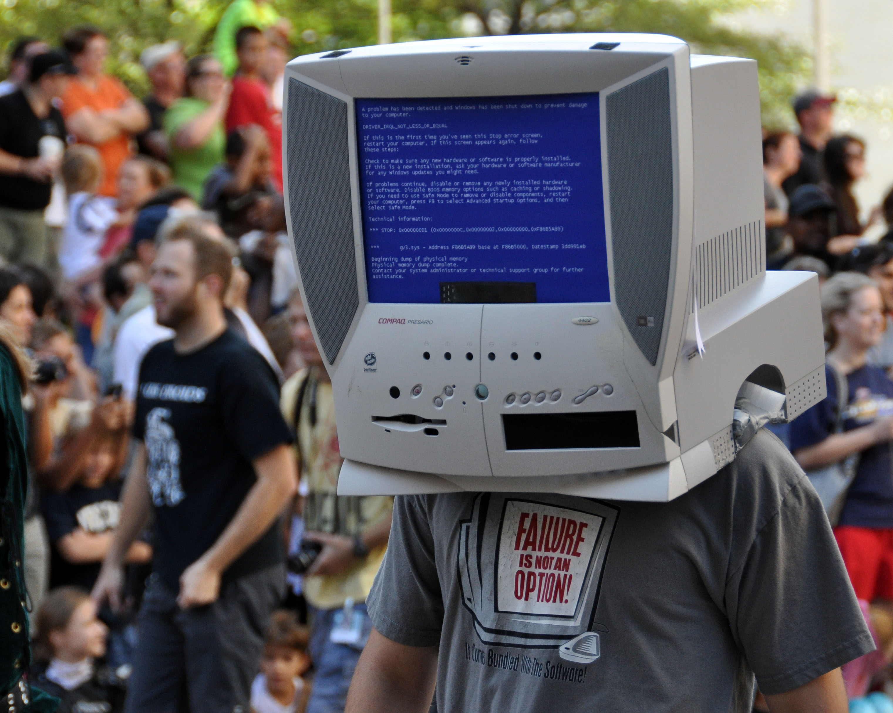

Slide 10
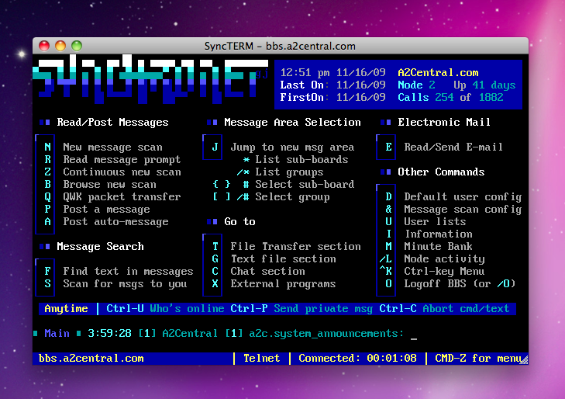

Slide 11


Slide 12
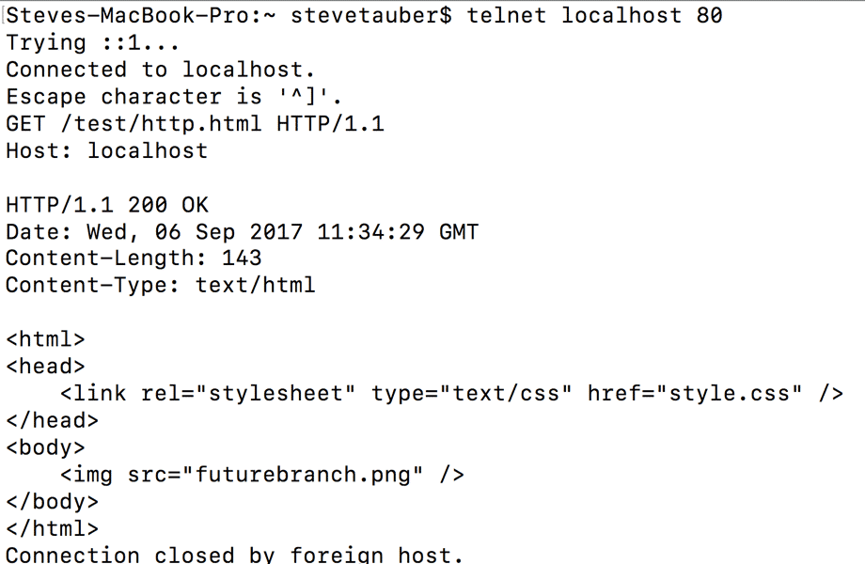

Slide 13
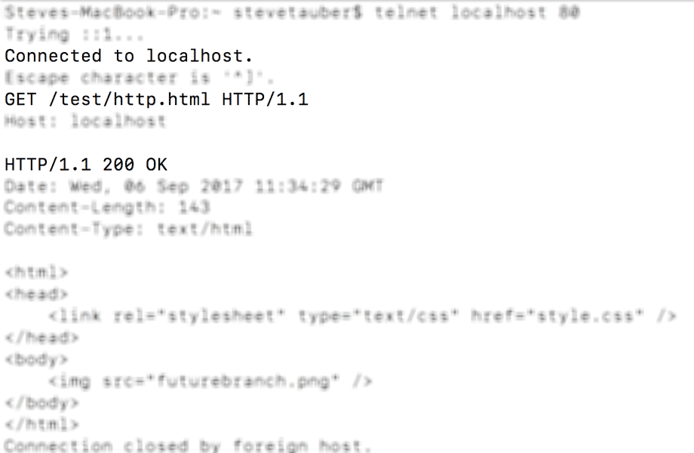

Slide 14
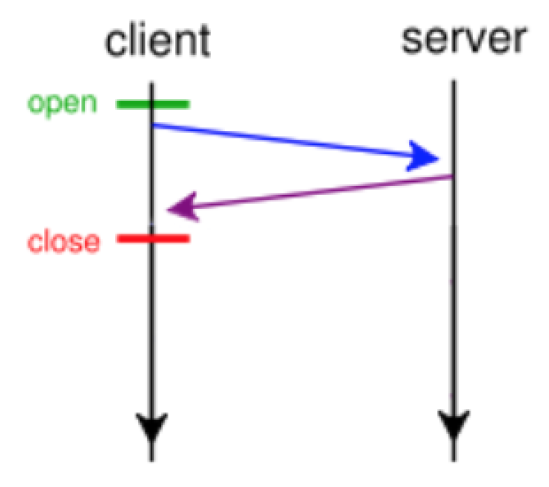

Slide 15
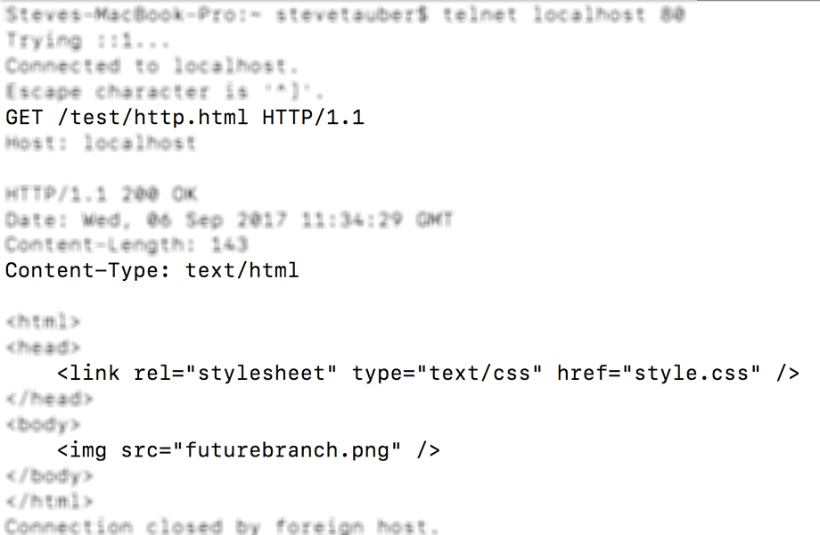

Slide 16
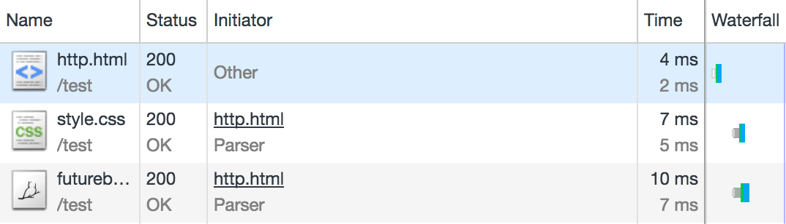

Slide 17
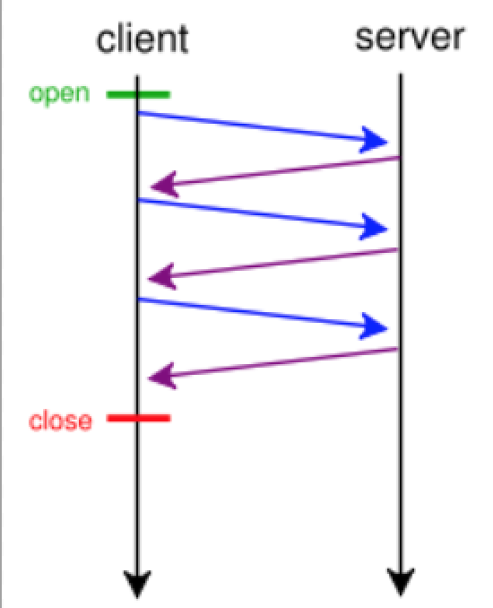

Slide 19
Questions?

Slide 20
No, this is terrible

Slide 21
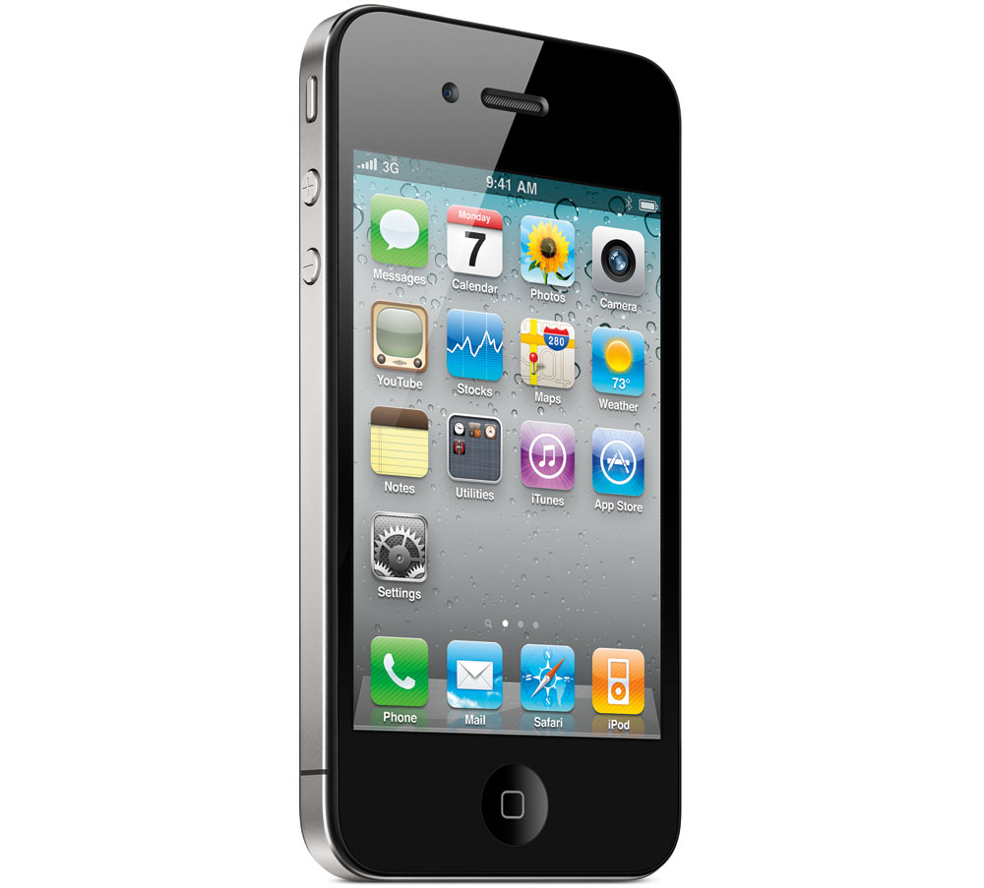

Slide 23
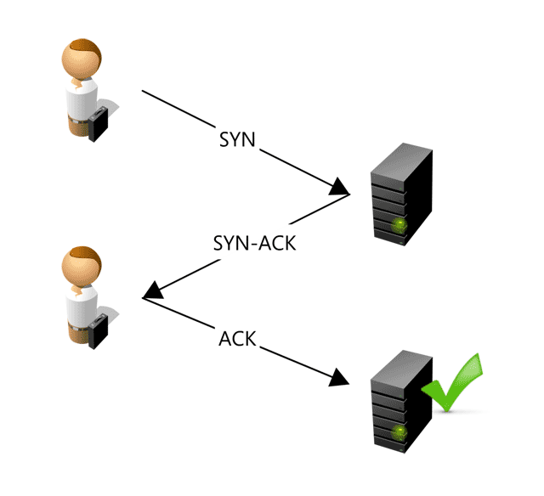

Slide 24
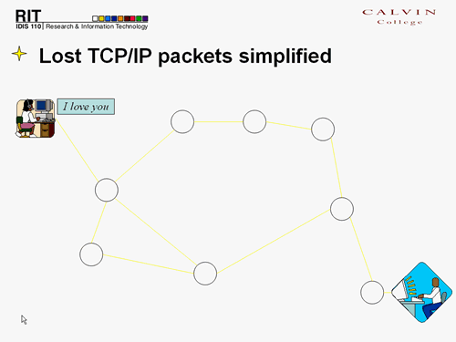

Slide 26
Problems
Many Requests (and Latency)

Slide 27
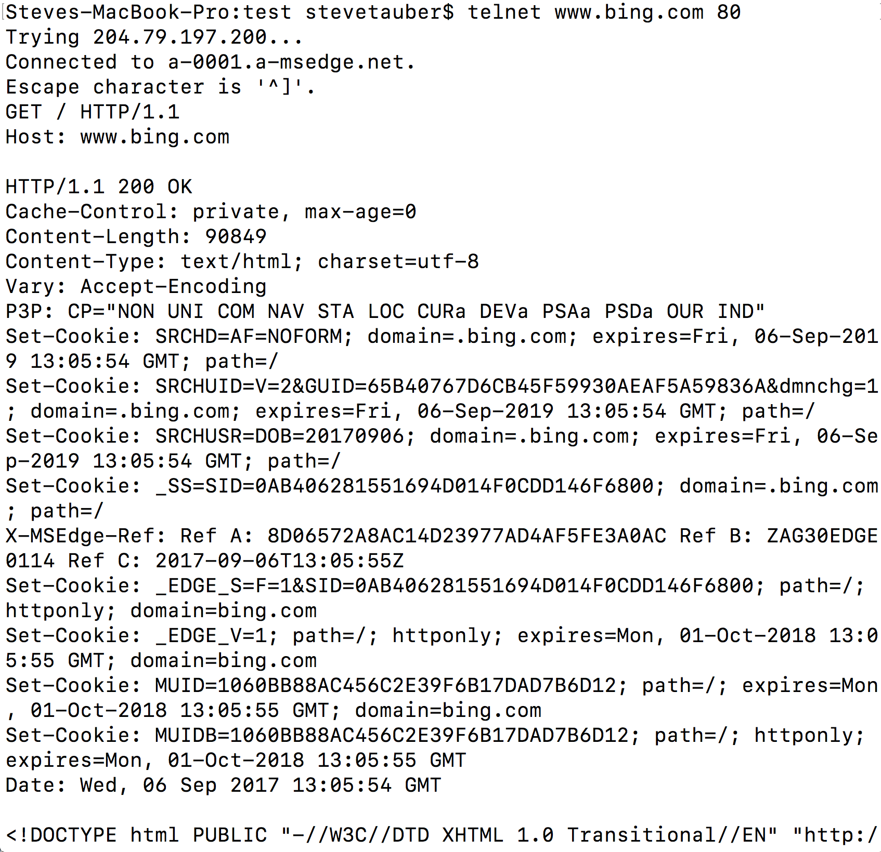

Slide 28
Problems
Many Requests (and Latency)
Headers

Slide 30
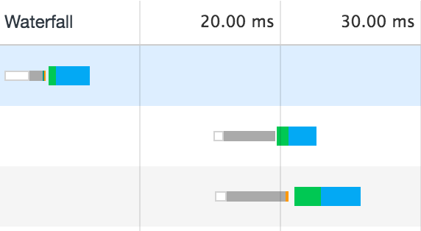

Slide 31
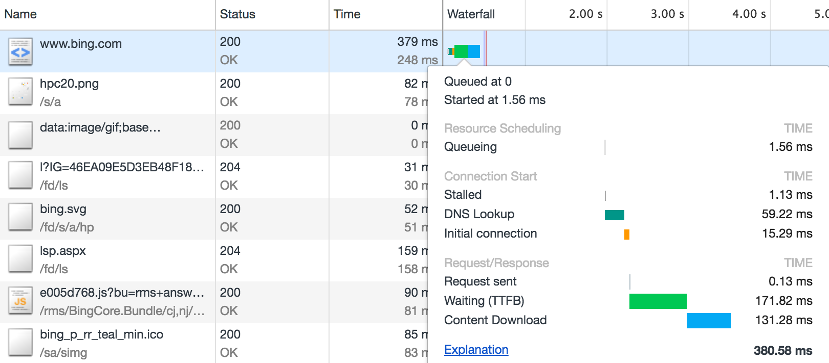

Slide 32
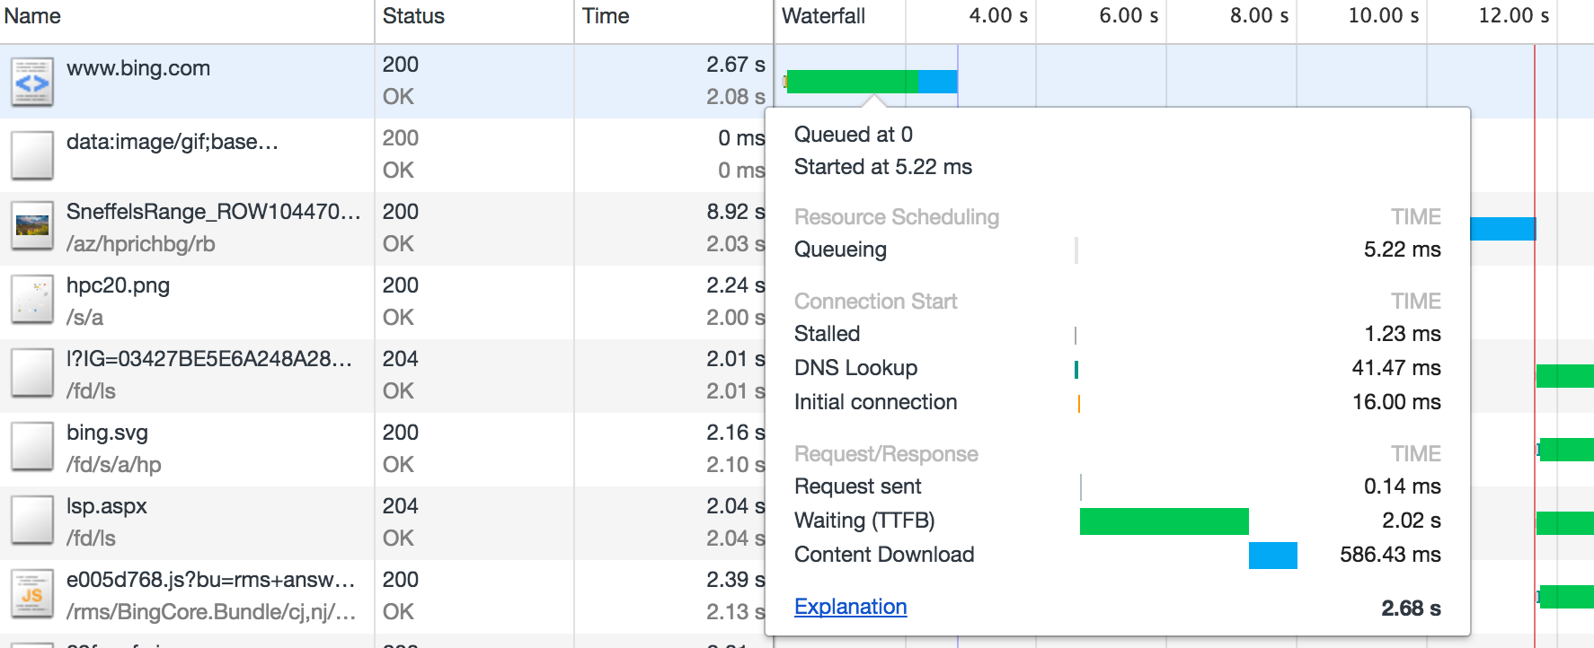

Slide 33
Problems
Many Requests (and Latency)
Headers
Request Delay (DOM)

Slide 34
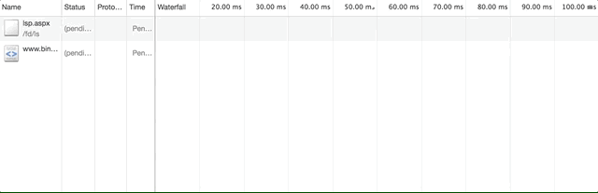

Slide 35
Problems
Many Requests (and Latency)
Headers
Request Delay (DOM)
Head of Line (Large Blocking File)

Slide 36
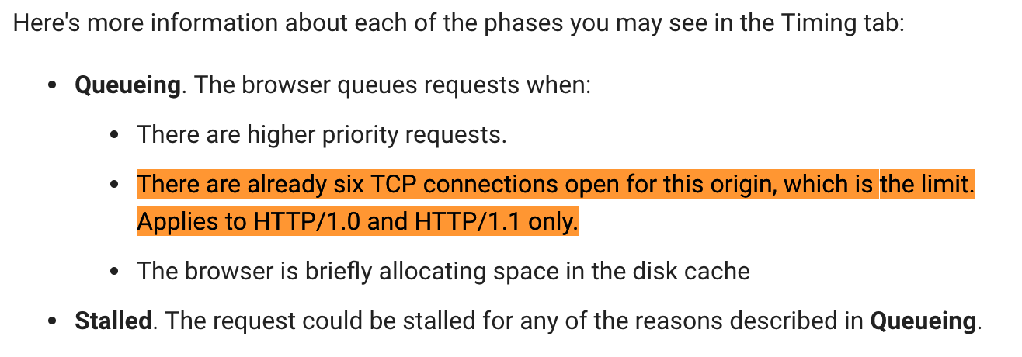

Slide 37
Problems
Many Requests (and Latency)
Headers
Request Delay (DOM)
Head of Line (Large Blocking File)
>6 Requests

Slide 38
Questions?

Slide 39
Problems
Many Requests (and Latency)
Headers
Request Delay (DOM)
Head of Line (Large Blocking File)
>6 Requests

Slide 40
Solutions!
Many Requests (and Latency)
Headers
Request Delay (DOM)
Head of Line (Large Blocking File)
>6 Requests

Slide 41
Solutions!
Many Requests (and Latency)
Headers
Request Delay (DOM)
Head of Line (Large Blocking File)
>6 Requests

Slide 42
Solutions!
Many Requests (and Latency)
Headers
Request Delay (DOM)
Head of Line (Large Blocking File)
>6 Requests

Slide 43
Solutions!
Many Requests (and Latency)
Headers
Request Delay (DOM)
Head of Line (Large Blocking File)
>6 Requests

Slide 44
Solutions!
Many Requests (and Latency)
Headers
Request Delay (DOM)
Head of Line (Large Blocking File)
>6 Requests

Slide 45
HTTP/2

Slide 46
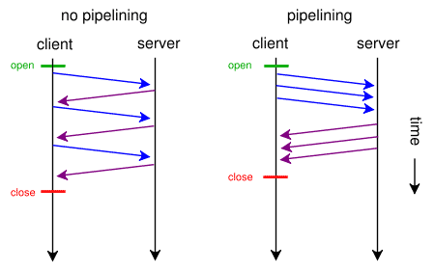

Slide 47
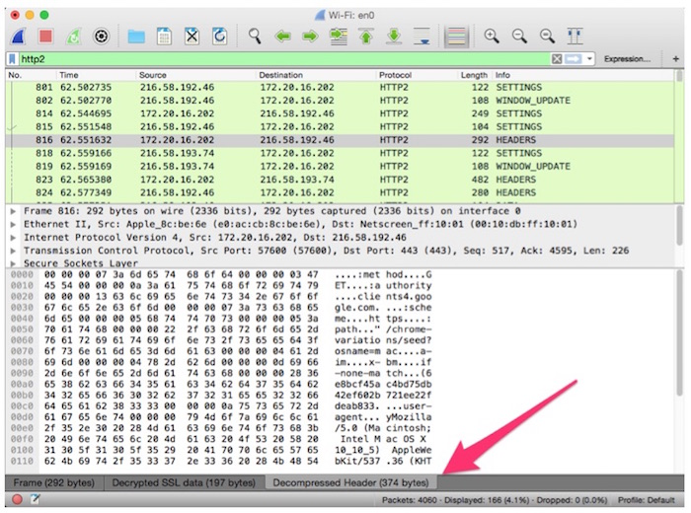
22% SAVINGS

Slide 48


Slide 49
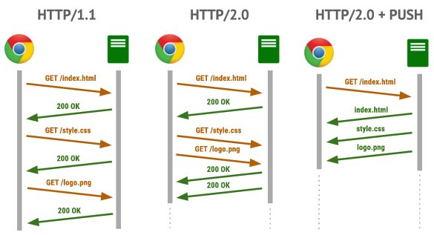

Slide 50
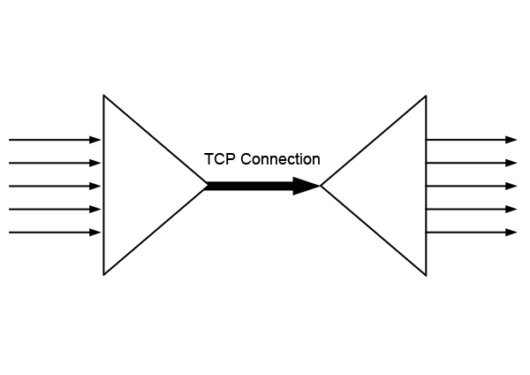

Slide 51
Solutions!
Many Requests (and Latency) Pipelining
Headers Header Compression
Request Delay (DOM) Server Push
Head of Line (Large Blocking File) Multiplexing
>6 Requests Multiplexing

Slide 52


Slide 53
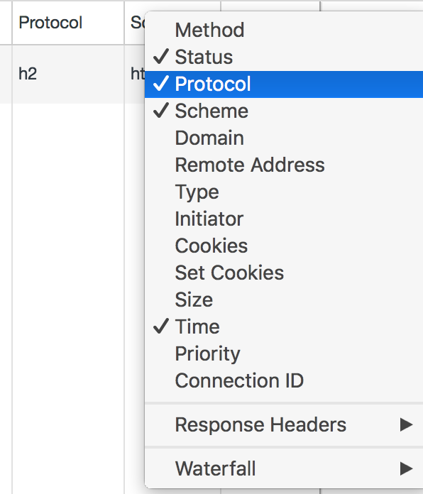

Slide 54
Now what?
Use HTTP/2
Small DOM / images
Use CDNs or static servers
Bundle your custom JS files
Reduce number of files
Use the network tab

Slide 55
Questions?

Slide 56
Photo Credits
http://maxpixel.freegreatpicture.com/Futuristic-Future-Time-Travel-Sci-fi-Quantum-1952518
https://upload.wikimedia.org/wikipedia/commons/thumb/9/9d/Sir_Tim_Berners-Lee.jpg/640px-Sir_Tim_Berners-Lee.jpg
https://upload.wikimedia.org/wikipedia/commons/a/a8/Dragon_Con_Compac_Man.jpg
https://www.flickr.com/photos/blakespot/4109394713
https://upload.wikimedia.org/wikipedia/commons/thumb/f/fb/HTTP_pipelining.svg/450px-HTTP_pipelining.svg.png
https://upload.wikimedia.org/wikipedia/commons/thumb/3/32/Tcp_normal_2.png/1123px-Tcp_normal_2.png
https://upload.wikimedia.org/wikipedia/commons/2/2c/Mobile-phone.jpg
https://www.calvin.edu/academic/rit/webBook/chapter3/Introduction/tcp.htm
https://giuseppeciotta.net/getting-to-know-http20-with-the-mosaic-demo.html
https://upload.wikimedia.org/wikipedia/commons/thumb/6/6f/Multiplexing_diagram.svg/1200px-Multiplexing_diagram.svg.png
https://blog.newrelic.com/2016/02/17/http2-production/

